Slide 1
C. elegans metabolomics
To assess toxicity and to identify toxic compounds in complex mixtures
Henrie Korthout
Fytagoras BV,
Leiden, the Netherlands
Subcontractor EFRO project

Slide 2
Metabolomics: study on all metabolites (compounds) present in complex mixtures (plant extracts, oil products/UVCB’s) or living cells, animals and humans
Ability to make variations in extracts of one and the same complex mixture → to obtain extracts of a specific UVCB with different ratios of compounds
Ability to profile the metabolic content (NMR, GC/MS, LC/MS)
Ability to measure the biological effect of the extracts in accurate bioassays (toxicity in C. elegans)
Find paterns (relationships) in metabolic content and bioactivity
Extract 1
Extract 2
Extract 3
UVCB 1
Example PSE extracts analyzed by GC-MS
EFRO 3R Toximeter

Slide 3
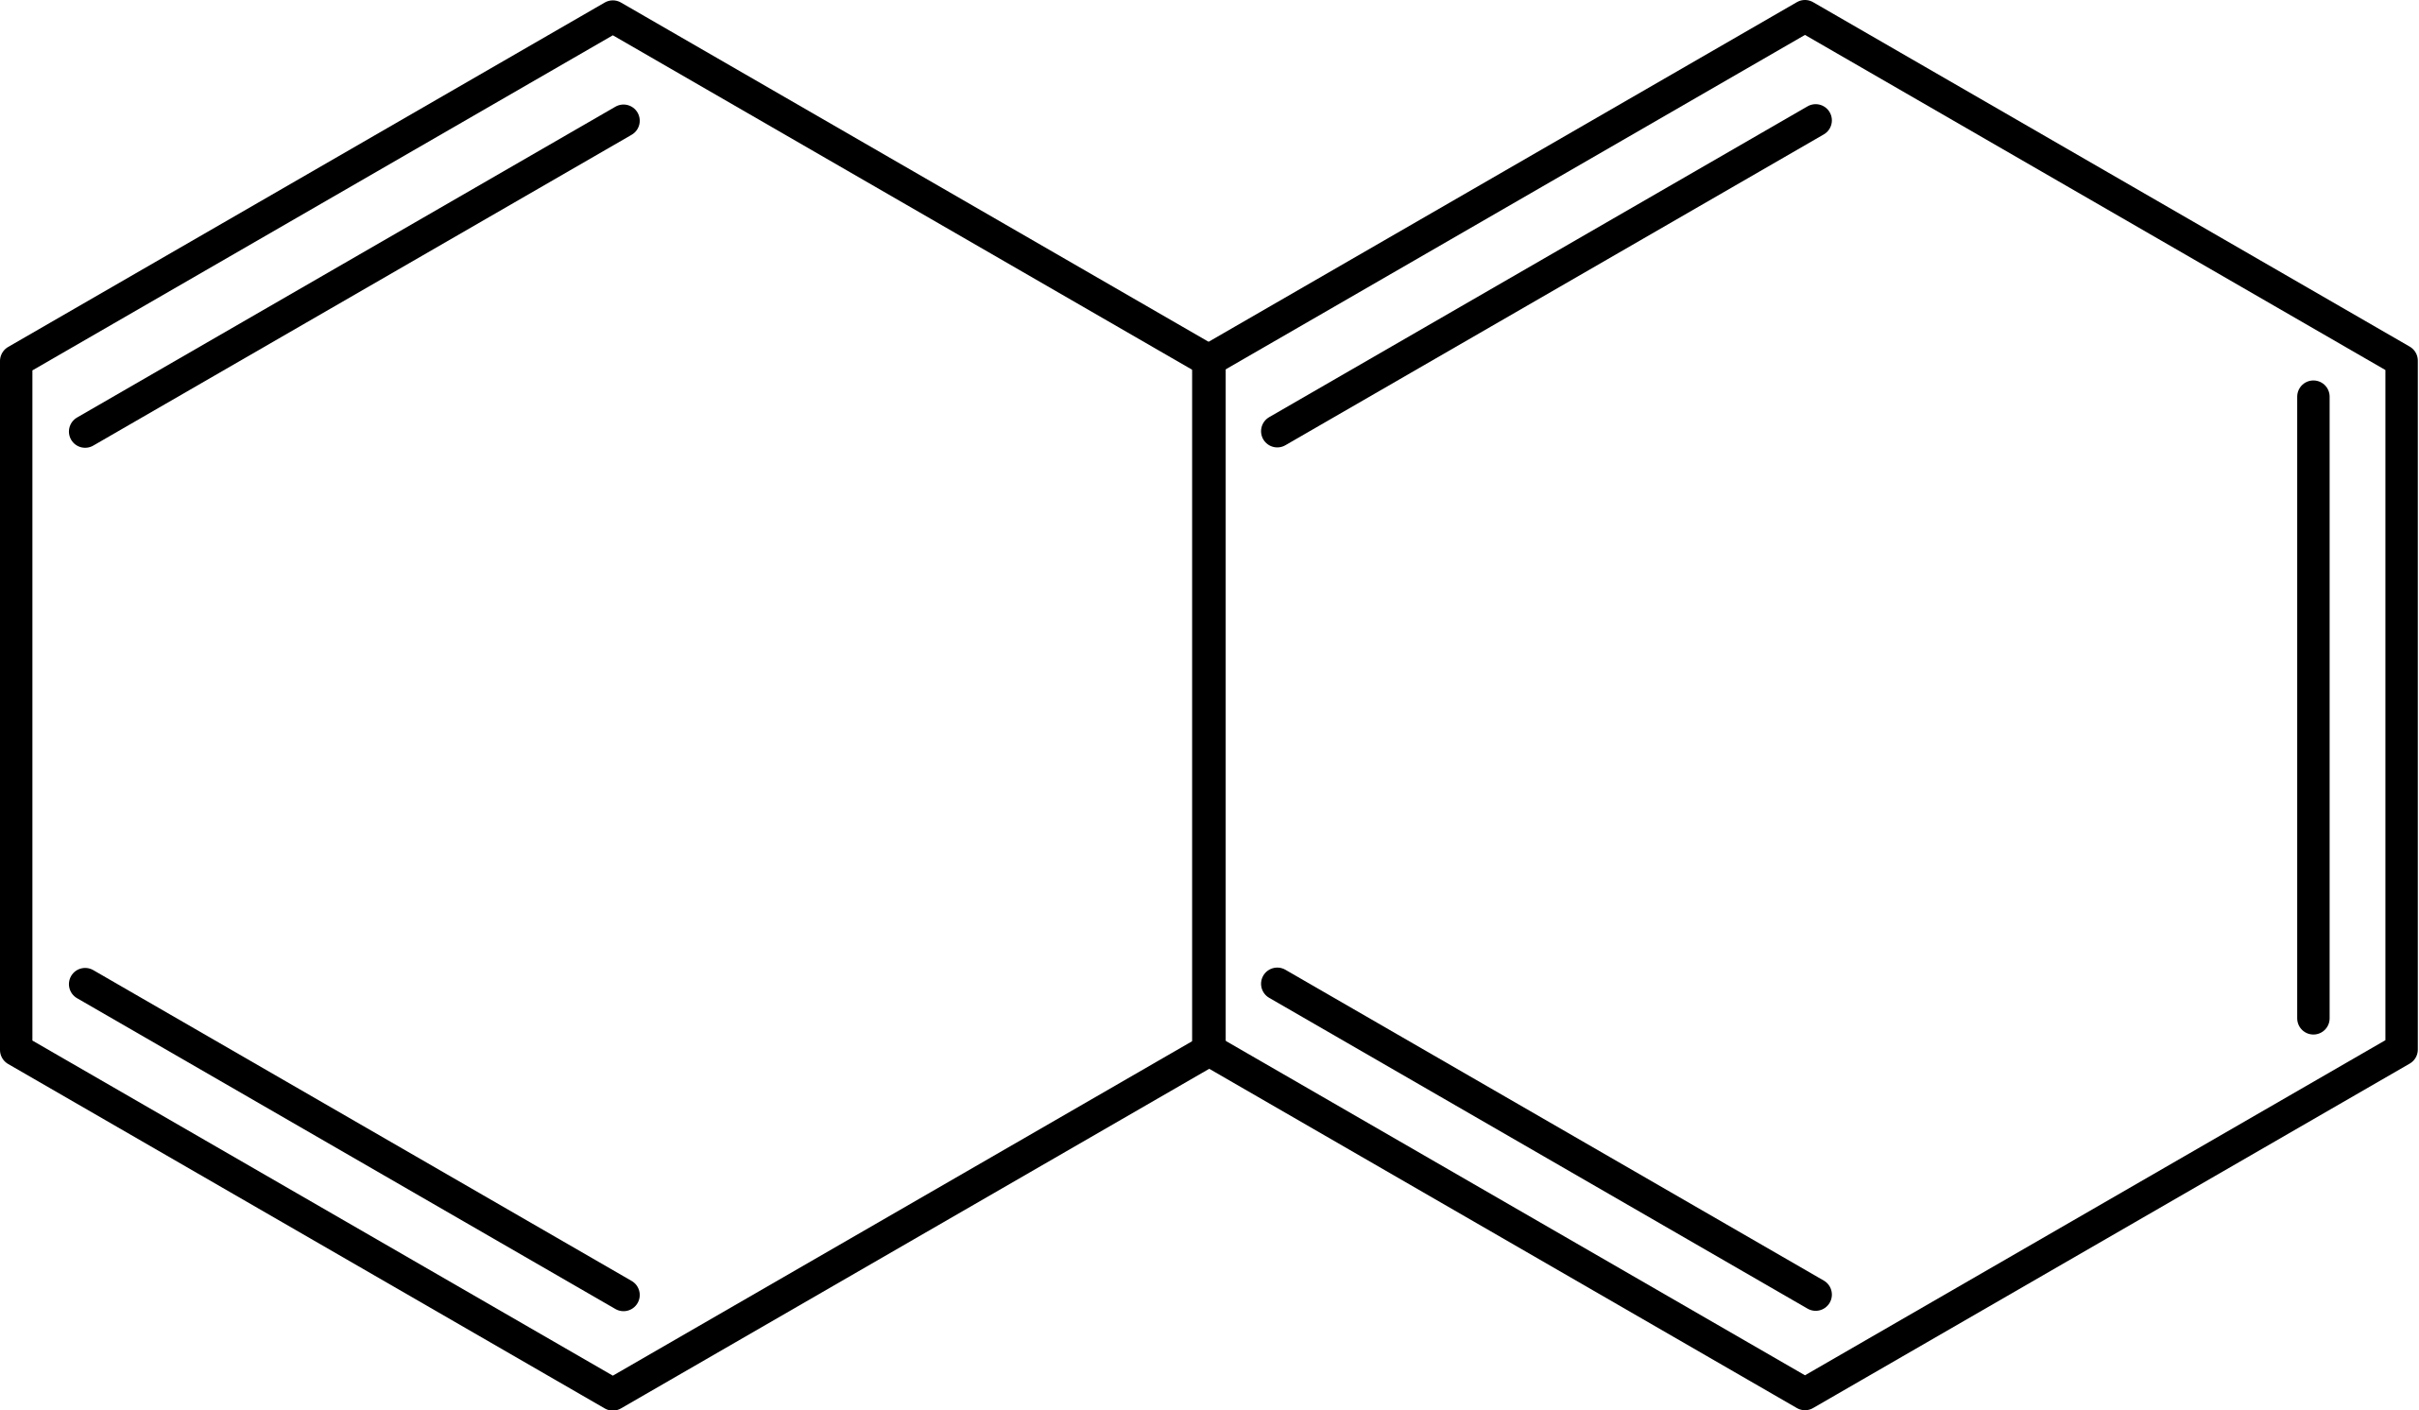
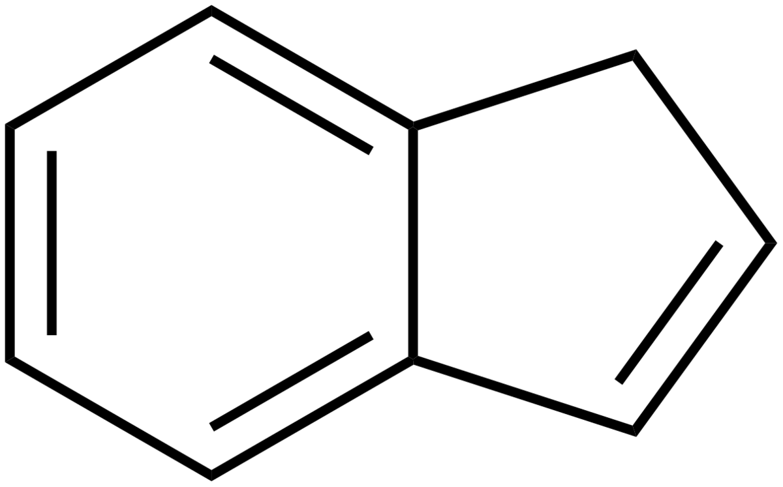
Pilot Study metabolomics in C. elegans
Test the effect of two toxic compounds Naphthalene and Indene + vehicles (control)
10.000 L4-stage nematodes cultivated in liquid medium
All exposures in triplicate
Exposure times: 24h, 48h and 72h
Harvesting freeze-drying nematodes
Extraction 2-phase to extract both polar and non-polar metabolites
metabolic profiling extracts by means of GC-MS
Data analysis

Slide 4
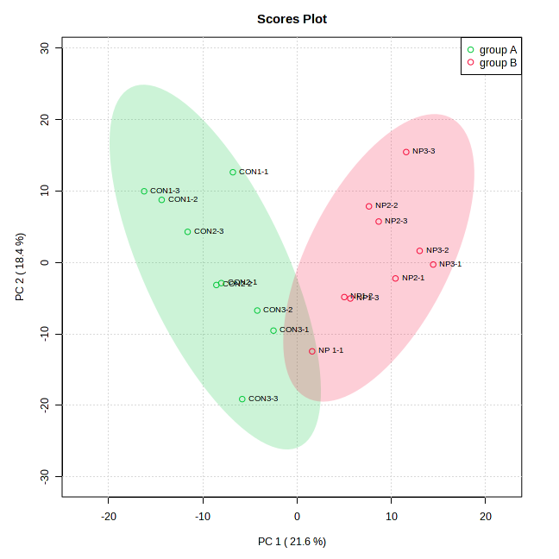
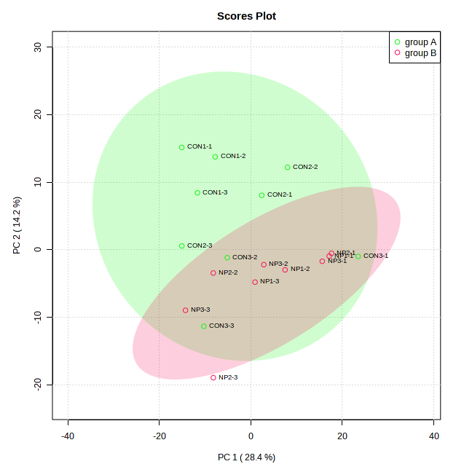
Results: 1. PCA analysis Naphthalene treatment
group A: vehicle group B: treated
* Non-polar fraction
* Polar fraction
24 hr
Time (development)
48 hr
72 hr
Toxicicity

Slide 5
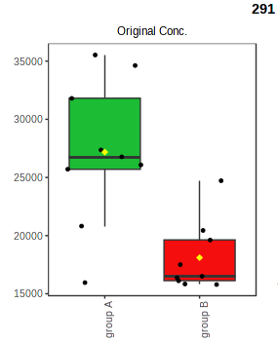
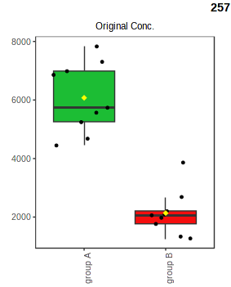
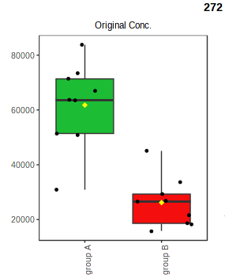
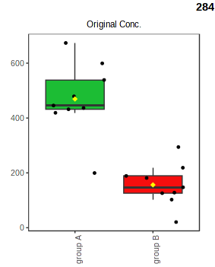
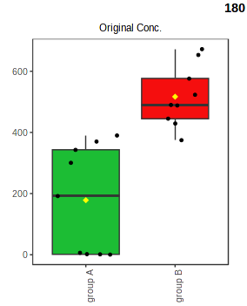
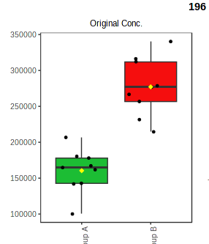
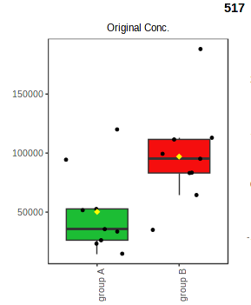
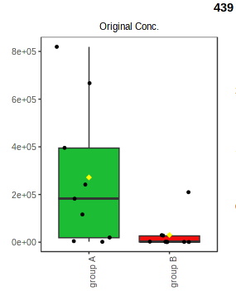
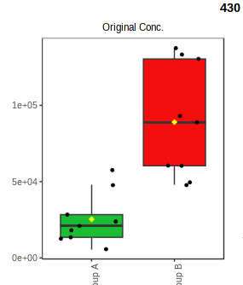
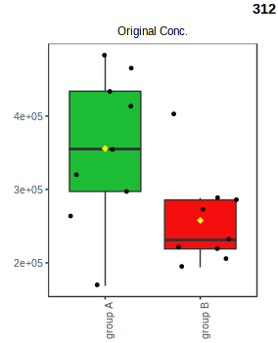
Key metabolites changes after treatment with naphthalene
vehicle
treatment
9,12-Octadecadienoic acid
1-Heptatriacotanol
1,25-Dihydroxyvitamin D3
Oleic Acid
cis-5,8,11,14,17-Eicosapentaenoic acid
Non-polar
metabolites
cis-4-Aminocyclo
hexanecarboxylic acid
glucose
trehalose
galactose
fructose
Polar
metabolites

Slide 6
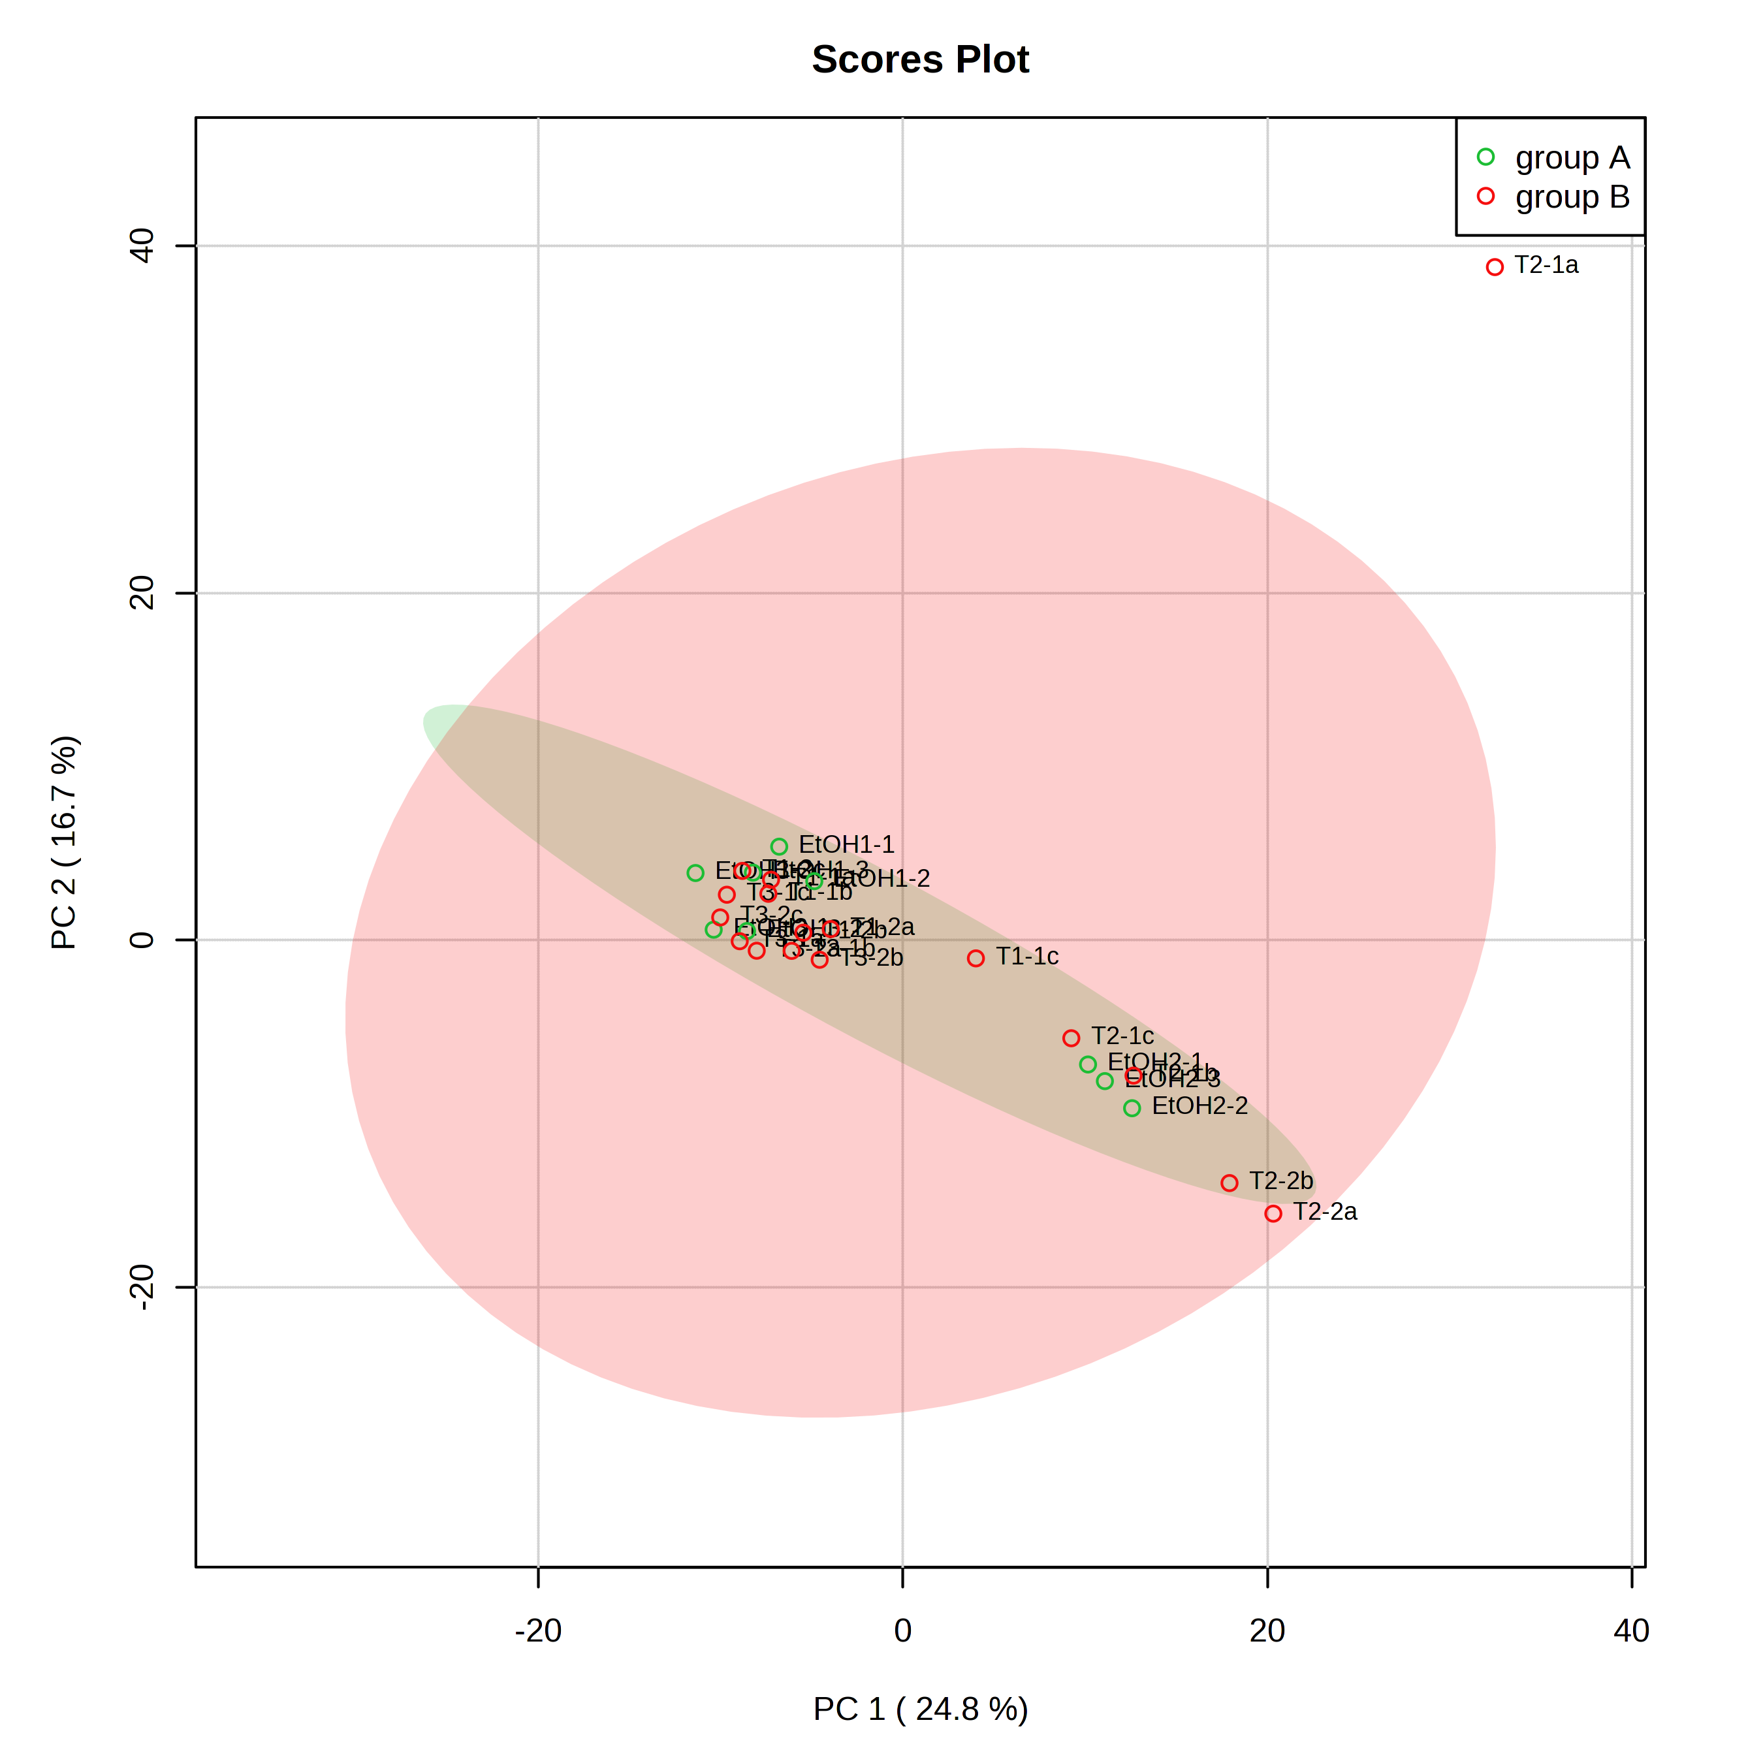
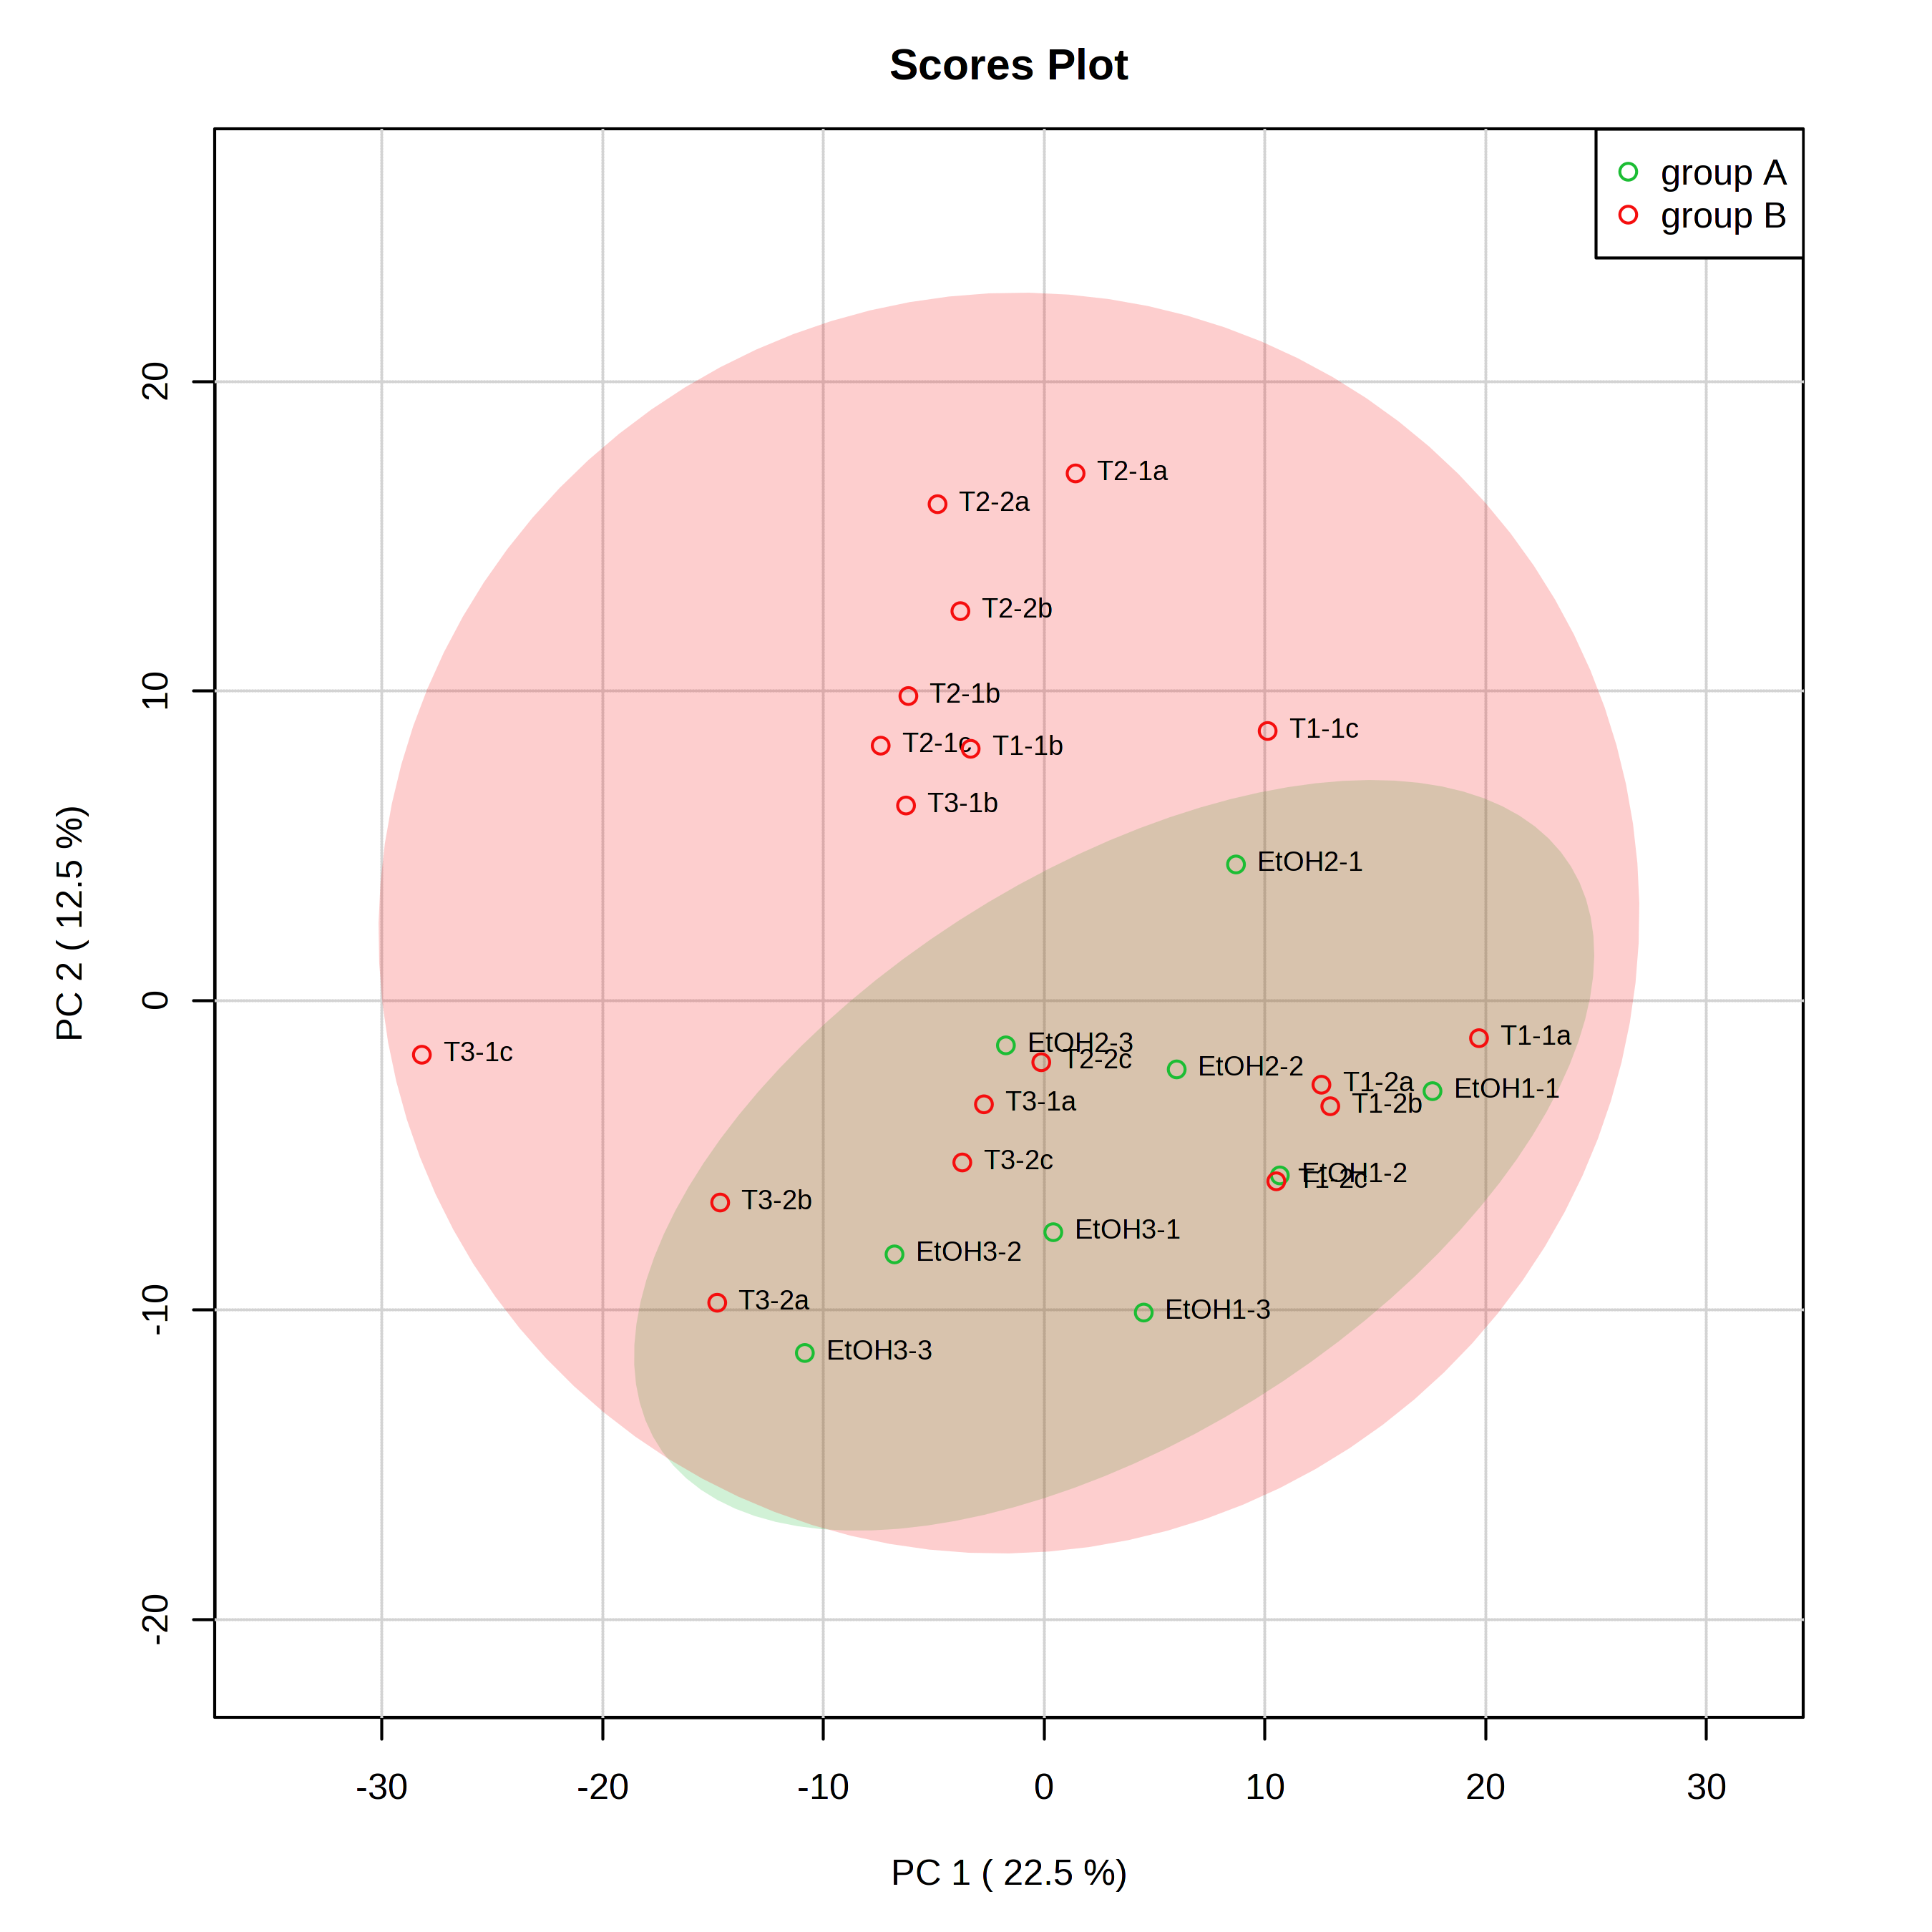
Results: 2. PCA analysis Indene treatment
group A: vehicle group B: treated
* Non-polar fraction
* Polar fraction

Slide 7
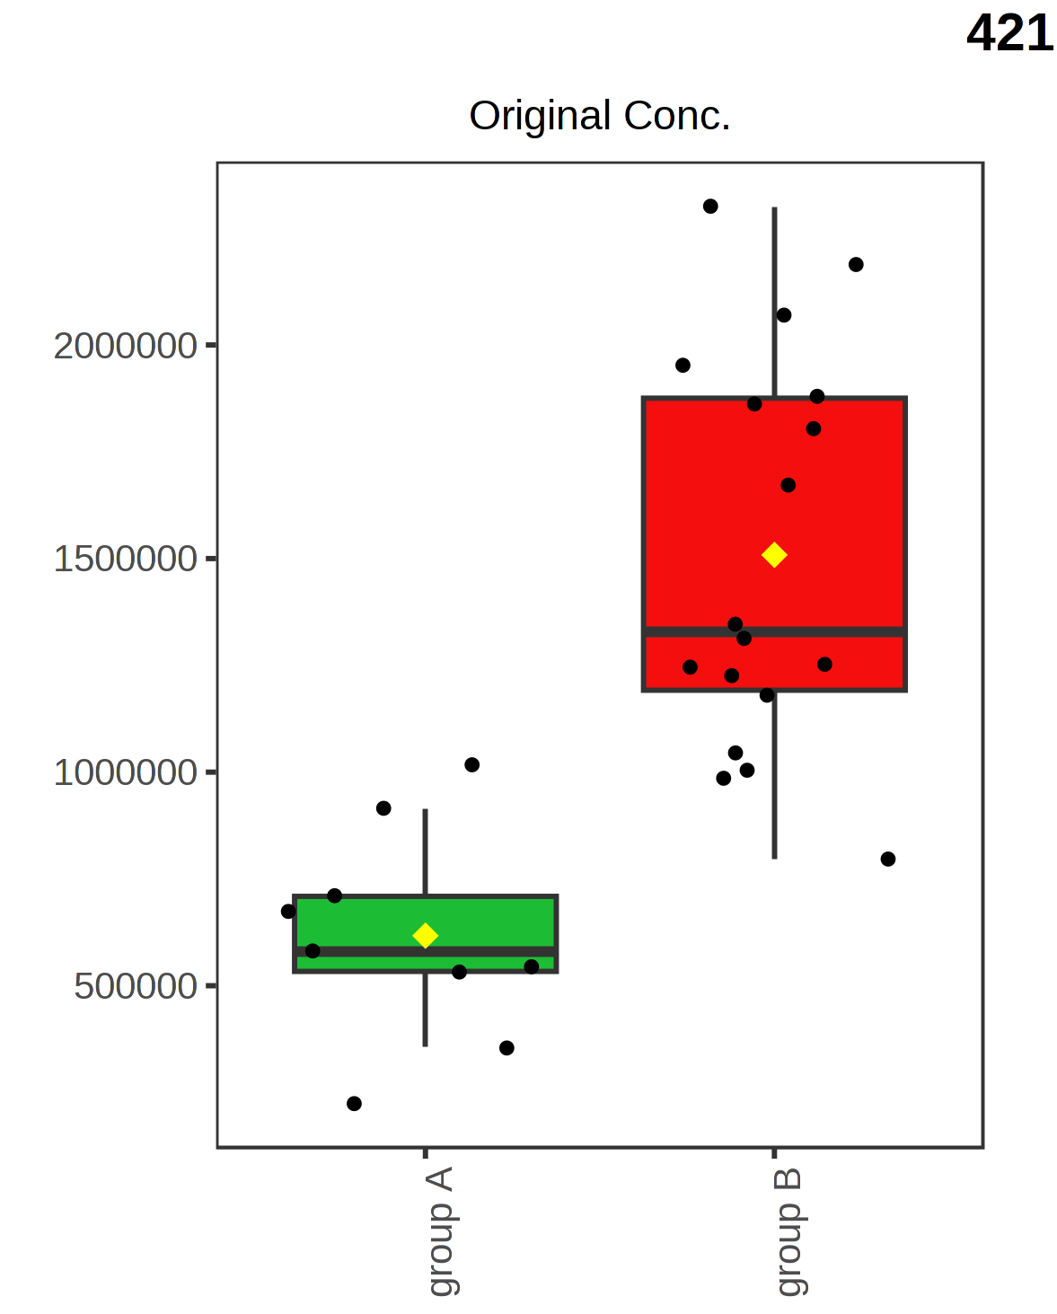
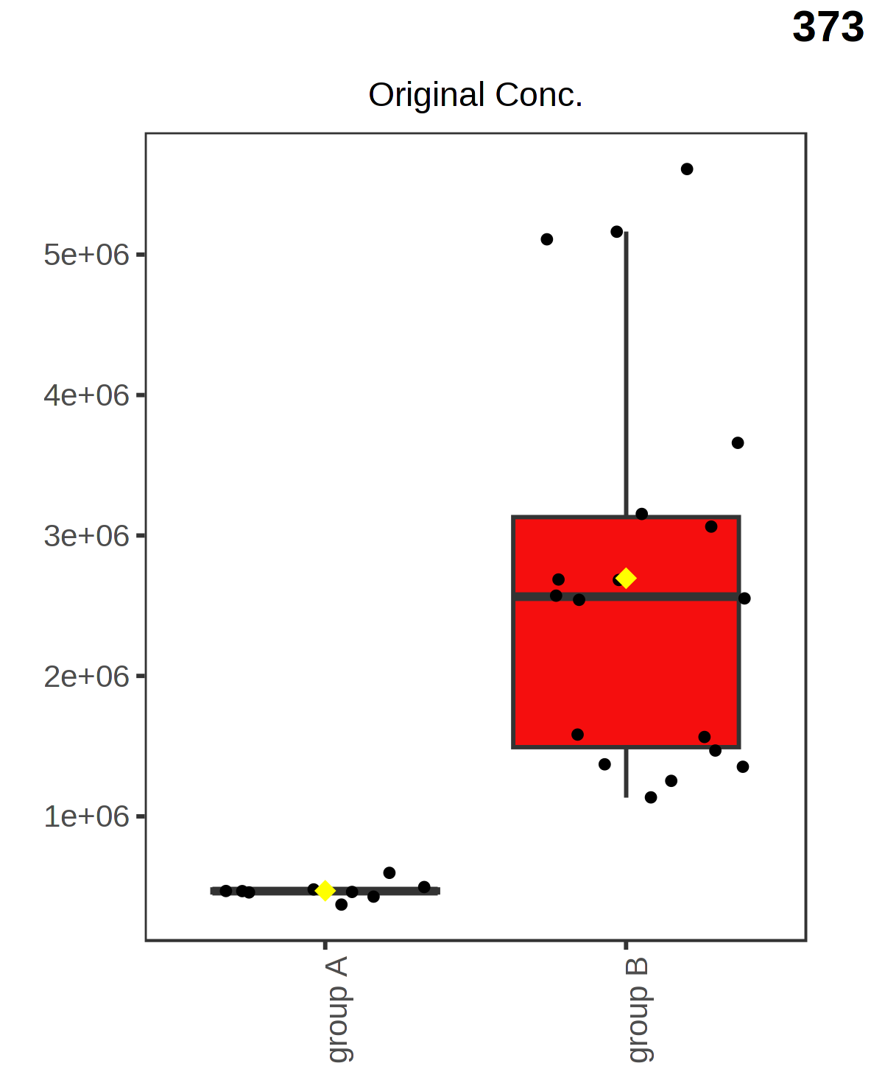
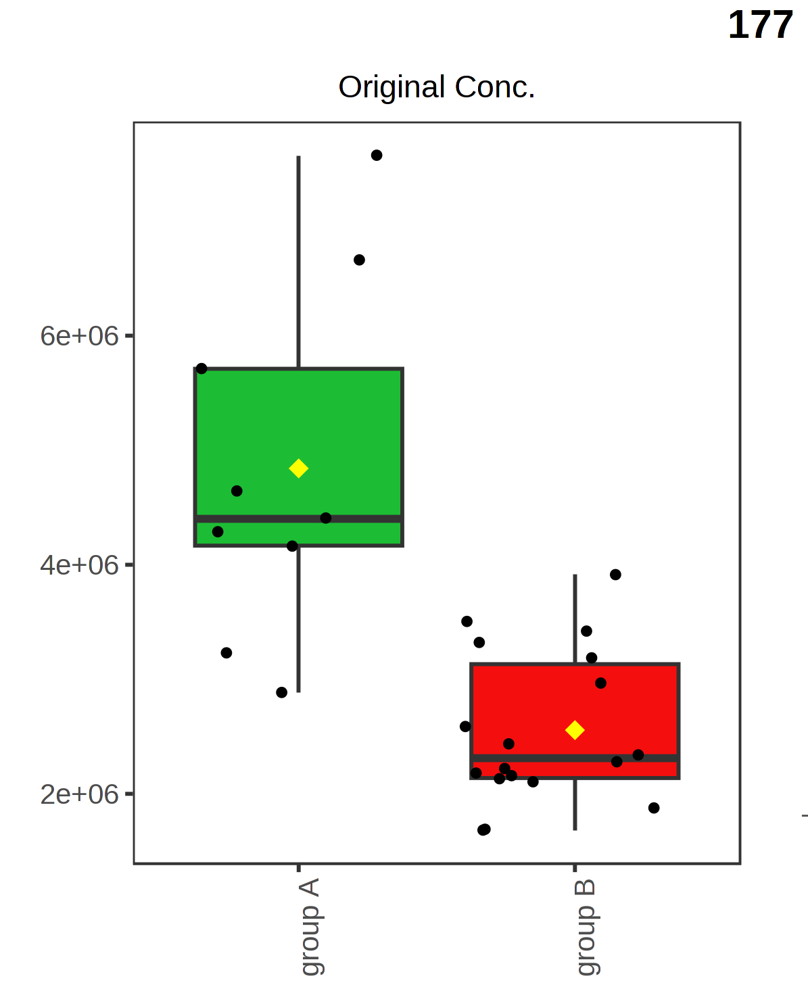
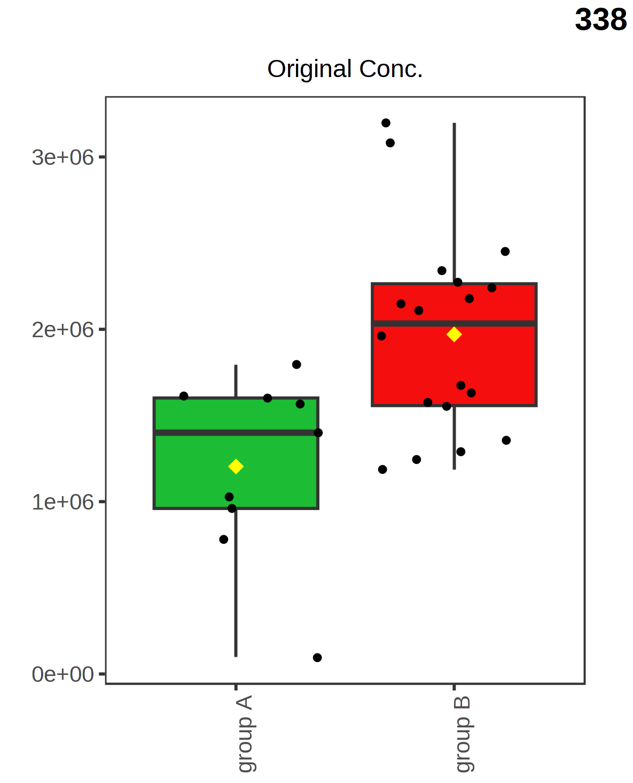
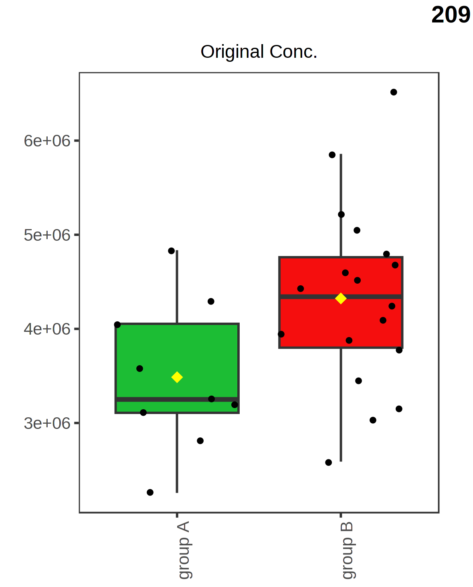
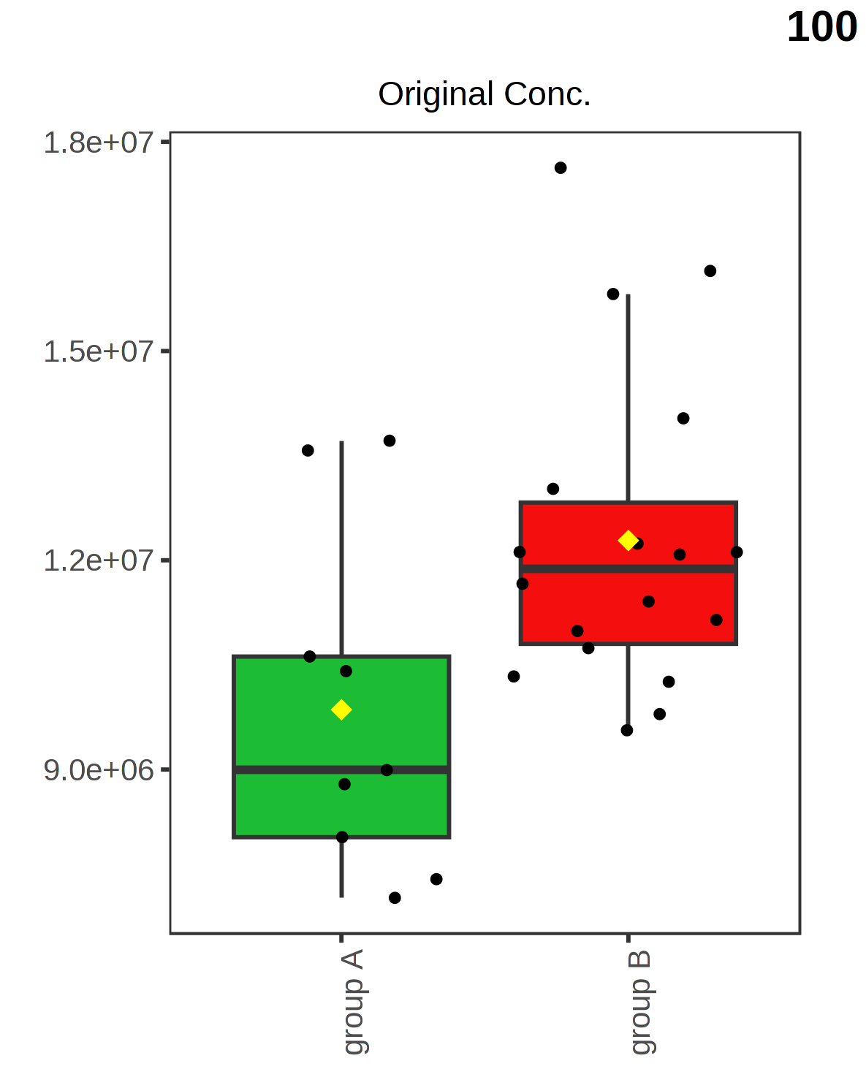
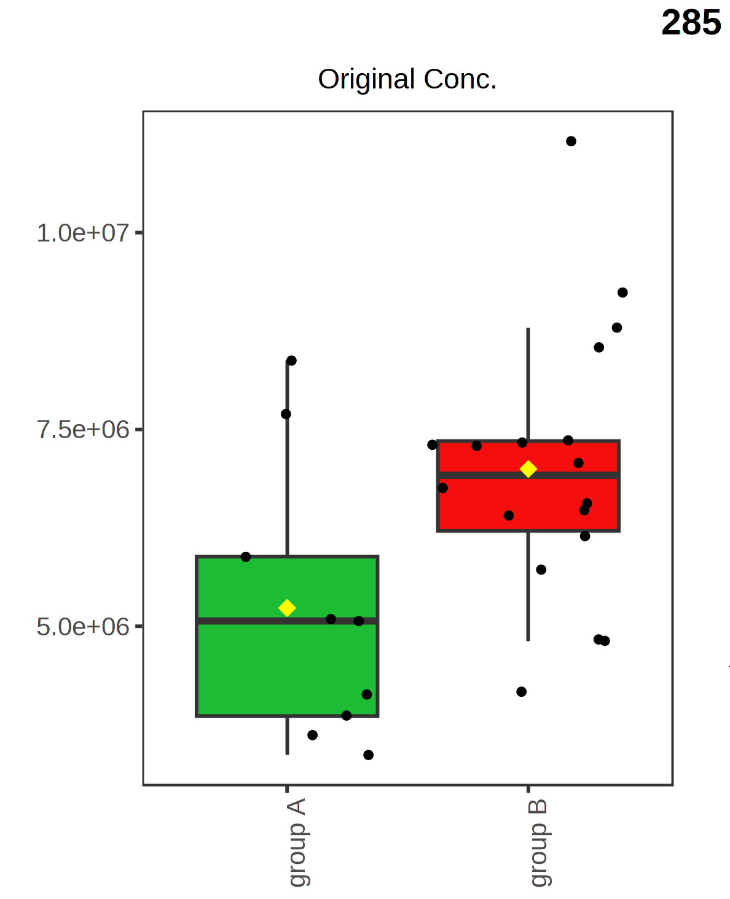
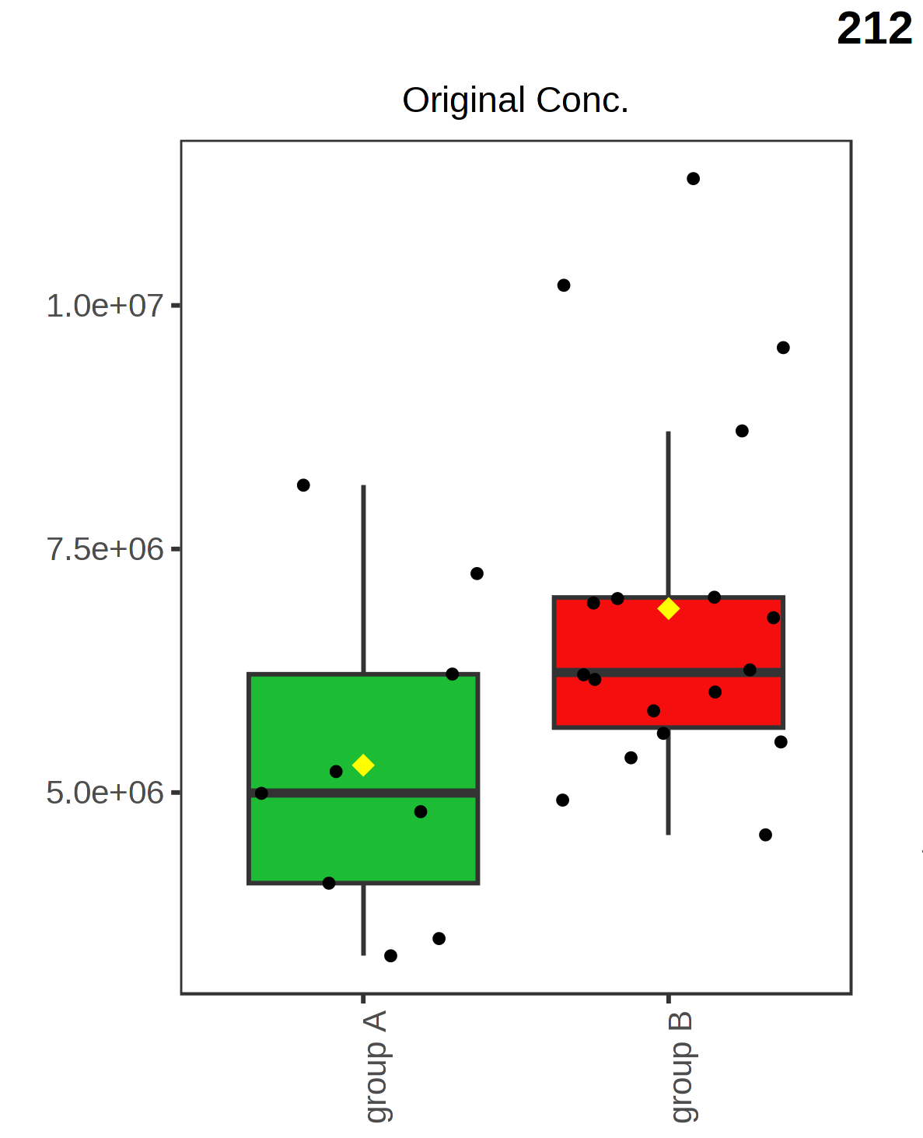
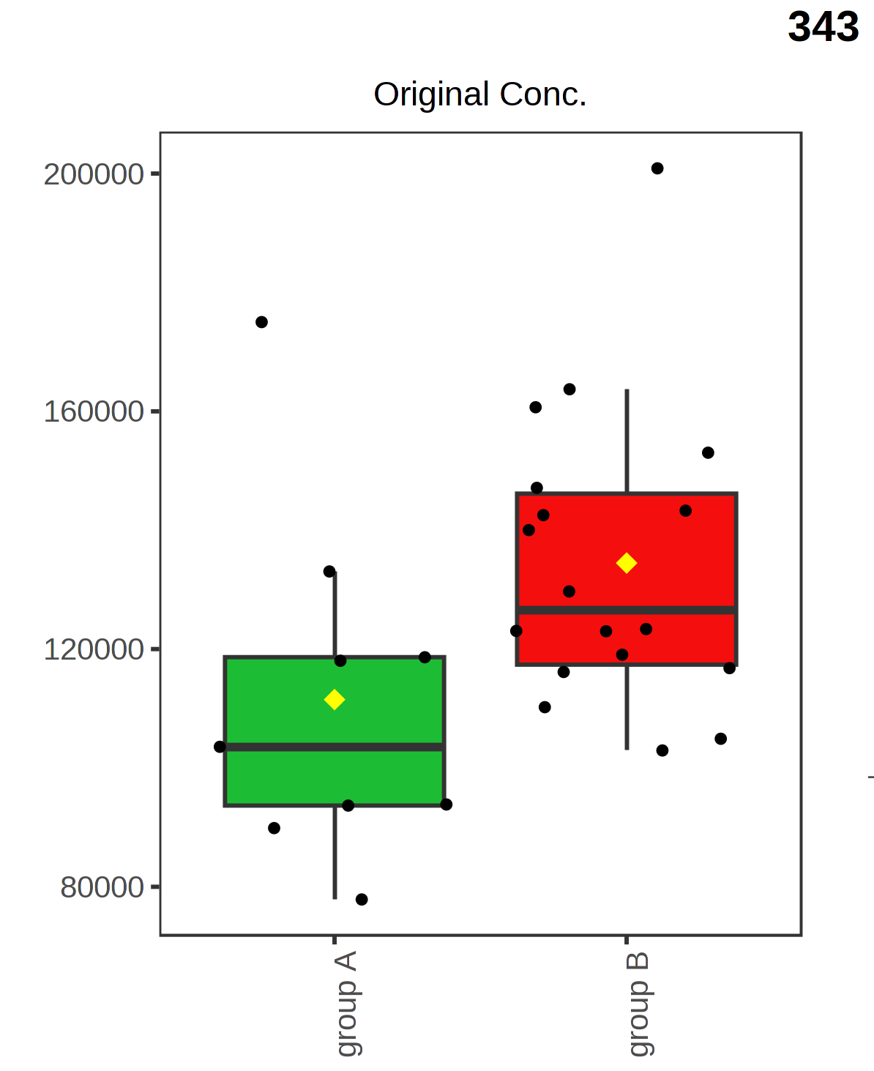
Key metabolites changes after treatment with Indene
vehicle
treatment
Fructose
D-Mannose
Malic acid
alpha.-D-Galactopyranose
L-Ornithine
L-Valine
L-Tyrosine
L-Phenylalanine
L-Tryptophan
Amino acids

Slide 8
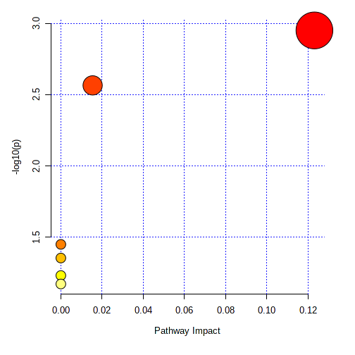
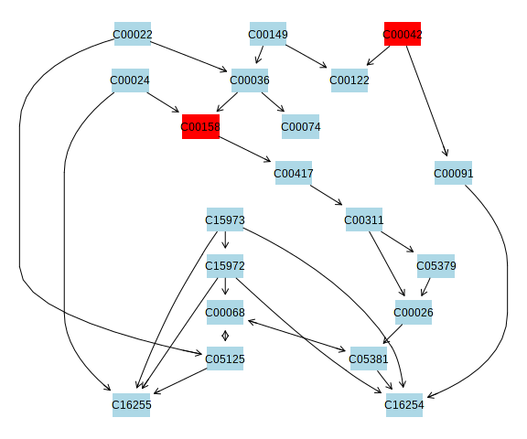
Summary
 | Non-polar metabolites | Polar metabolites
 |  | sugars | Amimo acids
naphthalene | Yes Effect in time | yes | no
indene | no | yes | yes
Toxic effects via different pathways
Pathway analysis MetaboAnalist 5.0

Slide 9
Thank you for your attention

